Slide 1
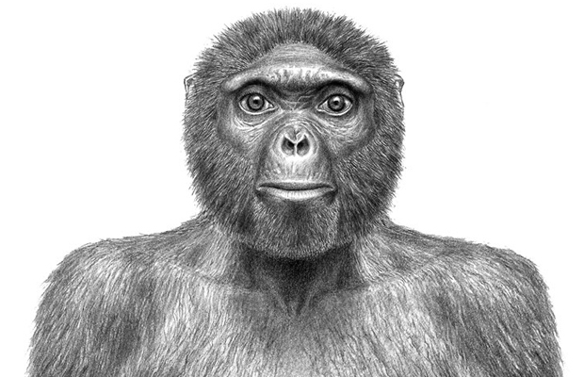
Ardi & Selam
Ardi is the name given to the skeletonized remians of a Ardipithecus ramidus. The remains are 4.4 million years old. Selam is the three year old fossilized skeletal remains of another Australopithecus afarensis. She is dated to be about 120,000 years older than Lucy.

Slide 2
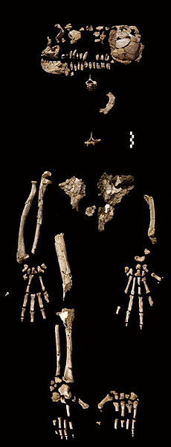
(Right) Recovered fragments of Ardi’s skeleton
(Left)A bust of Selam.

Slide 3
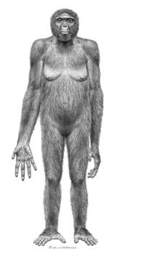
(Right) Selam’s skull
(Above) An artist’s rendition of Ardi

Slide 4
(Above) Zeresenay Alemseged discovered Selam in Ethiopia
(Below) Yohannes Haile-Selassie discovered Ardi when he was a college student

